Slide 1

WEATHER INFO USING API
TEAM MEMBERS :
N.Akhil – 19071A12C1
P.Srujana – 19071A12G1
G.Shivani – 20075A1215
4. T.Pavani - 20075A1219
Guided By:
Mrs.B.Srivani
Assistant Professor,
Department of IT,
VNRVJIET , Hyderabad.

Slide 2
Abstract
This Application basically displays the weather of the region which is to be searched . This application does retrieve a good number of weather features which can be used to predict weather or in the field of meteorology.
Through JavaScript we can retrieve the required data from the API which includes the whole integer values of temperatures.
In this project we use two API’s : one for current day and the other for a 5-day weather forecast.
API is one of the software technologies where it requires it’s BASEURL and it’s key .

Slide 3

Introduction
Weather forecasting can be defined as the act of predicting future weather conditions or an attempt to indicate the weather conditions which are likely to occur.
Weather apps enables the users to get instant weather conditions by just typing the region name.
This application utilizes weather API to get real time data of that place which we want to know.

Slide 4
Existing System
The web Application (Google weather) as notification which shows the only temperature and day but doesn’t show other characteristics
Current Day Weather has many characteristics like wind , humidity, temperature, wind directions and many others.
Thus, we took this measure and built this web application.

Slide 5
Proposed System
Main stages of Proposed System:
Wireframe Creation : To develop any web application, creating its basic blueprint is crucial as based on the framework functionalities differ.
Website Structuring : Structuring defines the initial build which is accomplished through HTML(Hypertext Markup Language).
Website Styling : To create attractive web applications CSS(Cascading Style Sheets) is implemented.
Website Functionality : To make the components of initial build to be functional JS(JavaScript) , based on the service it has different frameworks.
Testing the Application : Running the application against test cases could lead to further improvement before submitting to the client.

Slide 6
Software and Hardware Requirements
Software Requirements:
The following software was used for the implementation of the system:
Any text editor for HTML, CSS, and JavaScript.
Debugging tools pesticide and json viewer to make debugging simpler.
Any search engine for web application.
3.5 Hardware Requirements:
The following hardware was used for the implementation of the system:
4 GB RAM
10GB HDD
Intel 1.66 GHz Processor Pentium 4

Slide 7
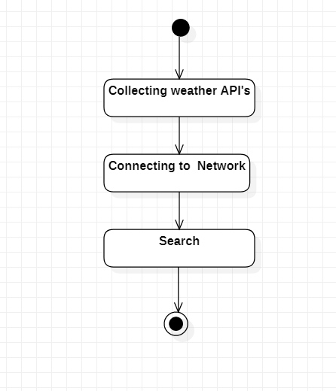
Workflow Diagram

Slide 8
Methodology
Speaking of non-technological aspect, scientists use satellite data, radiosondes, supercomputers and others . When it comes to people’s requirement, and they need instant weather information of a region , the models use API’s .
These API’s fetch the real time information about the weather type, weather conditions and other real time information.

Slide 9
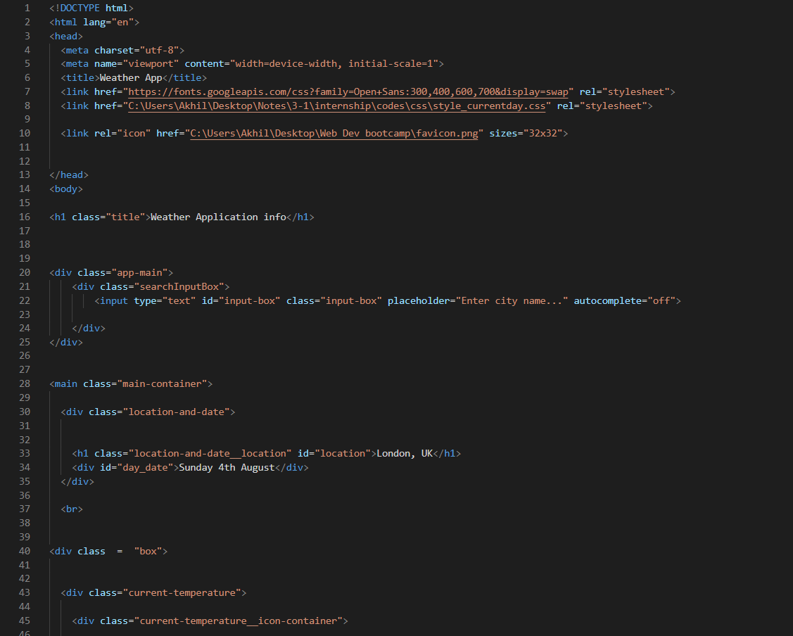
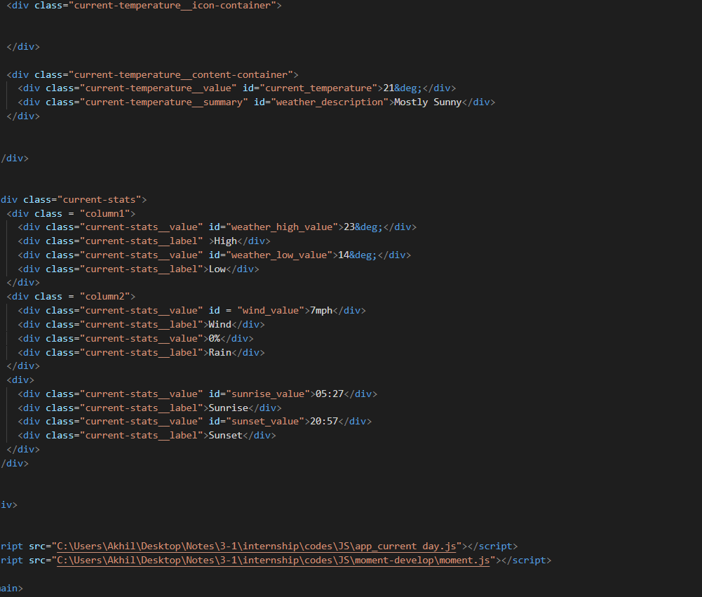
Implementation Code
HTML :

Slide 10
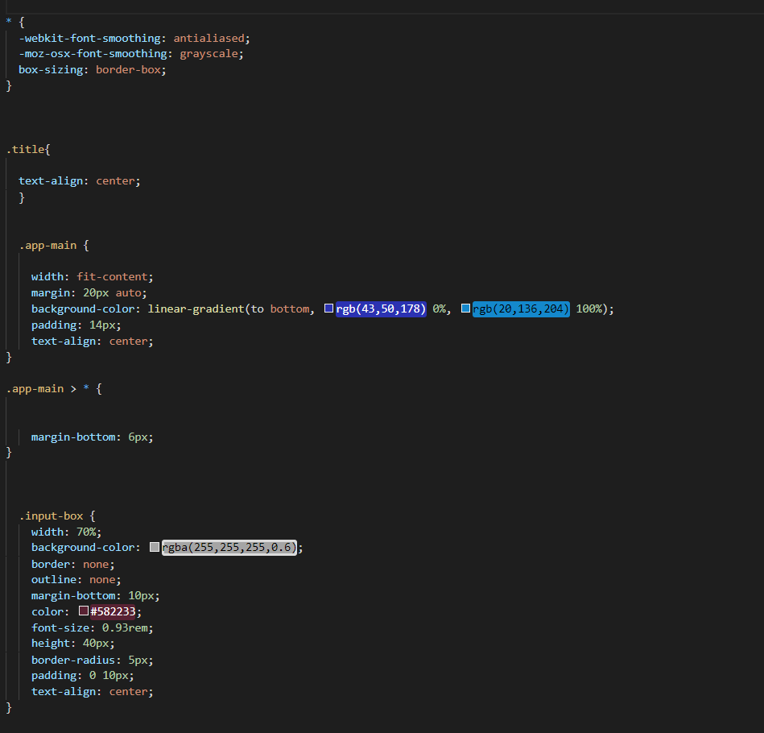
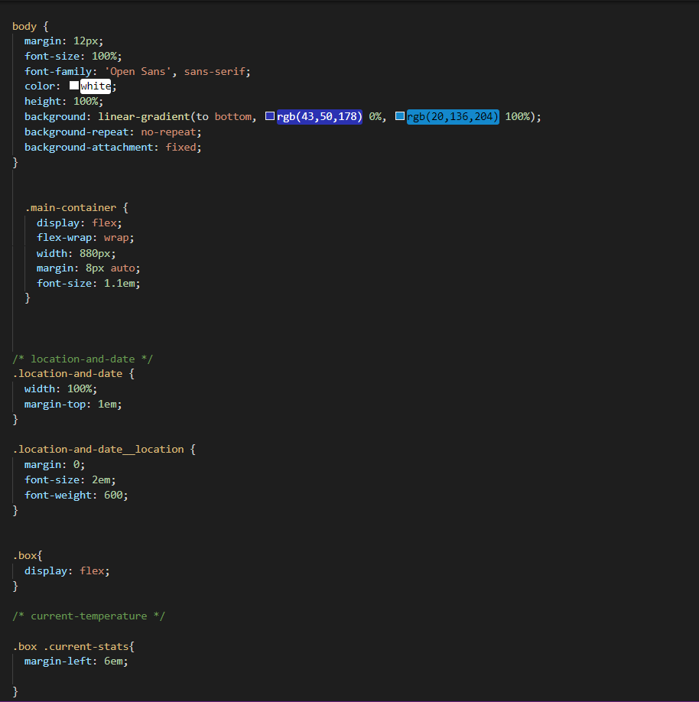
CSS :

Slide 11
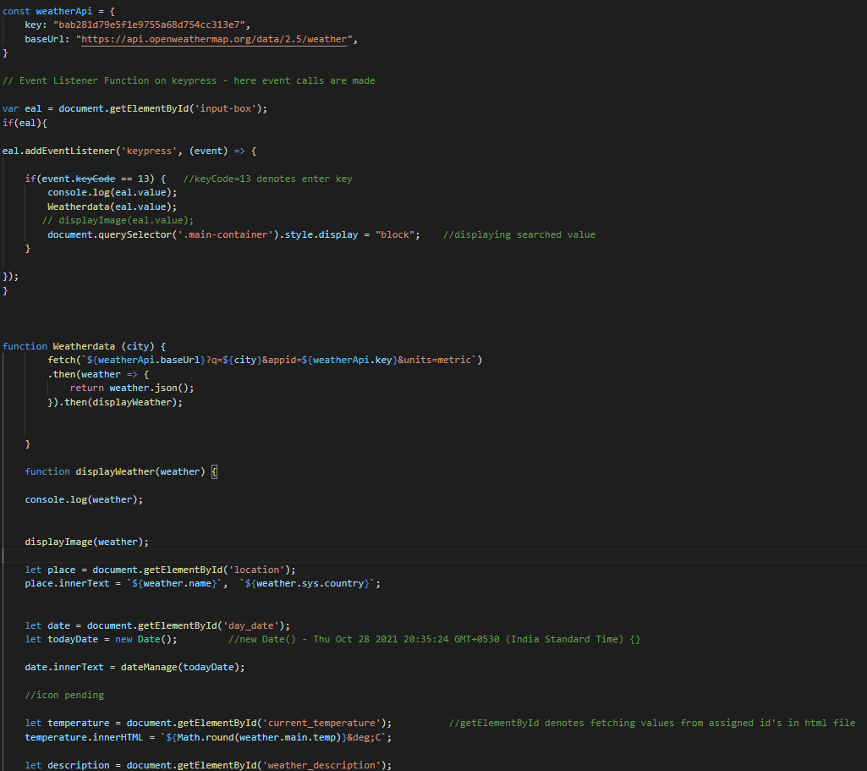
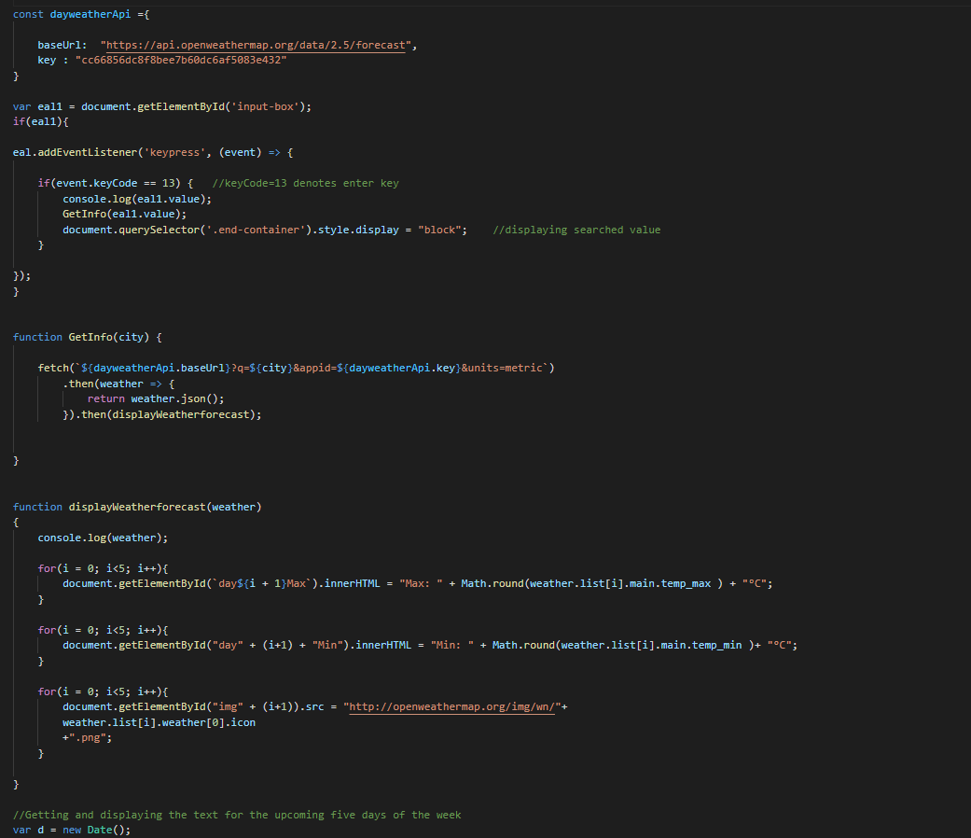
JS :

Slide 12
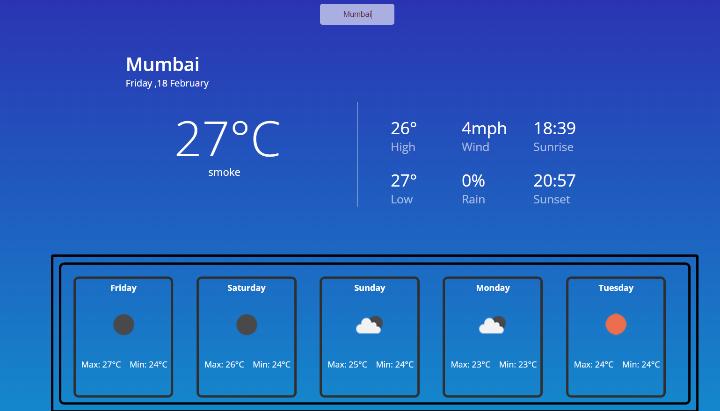
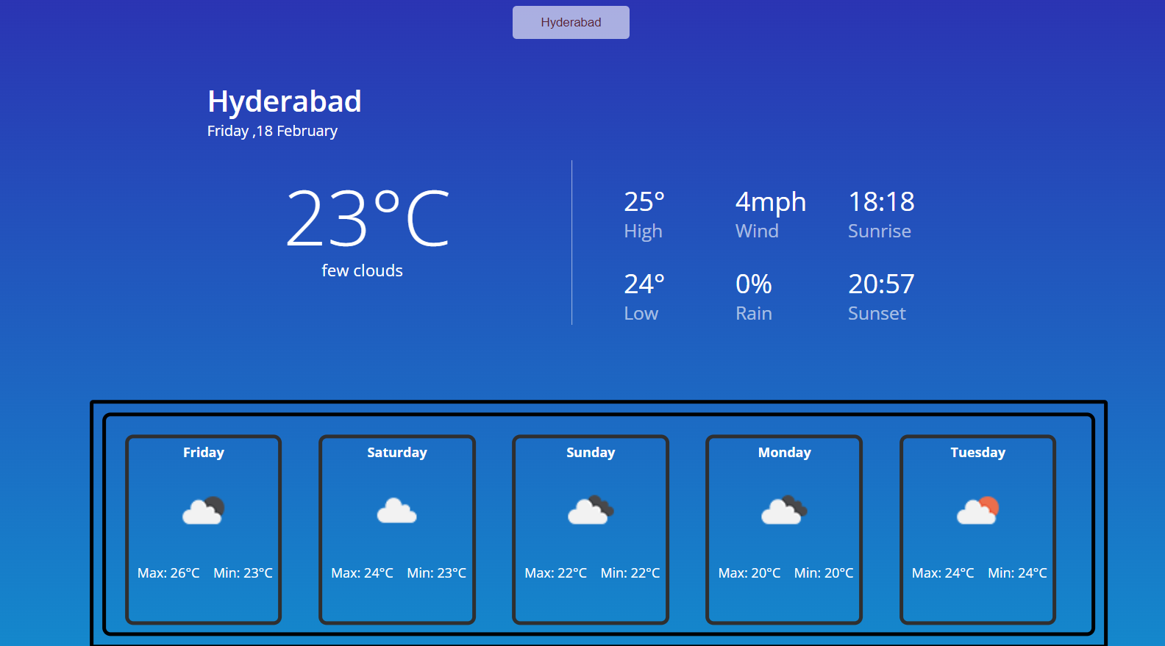
Output Screenshots

Slide 13
Conclusion and future scope
We would like to conclude that weather plays an important role in our daily life , the forecasts are important which determines what to wear that day.
Looking at the current weather information help the users to plan our trips , helps for small scale android app users with this application when they want to know the current weather of a place instantly .
This application is also useful to the farmers such that they can take necessary measures to protect their crops.
We would like to implement Node JS and Next JS to reduce the threshold for developer.
Every existing system should add this features which enhances previous results.

Slide 14
References
The Weather Research and Forecasting Model: Overview, System Efforts, and Future Directions
https://doi.org/10.1175/BAMS-D-15-00308.1
2. "94.05.01: Meteorology". teachersinstitute.yale.edu. Retrieved January 14, 2020.
https://teachersinstitute.yale.edu/curriculum/units/1994/5/94.05.01/2
3. Lynch, Peter (2006). The Emergence of Numerical Weather Prediction. Cambridge University Press
https://assets.cambridge.org/97811074/14839/frontmatter/9781107414839_frontmatter.pdf

Slide 15


